Slide 1
JAVA BASICS
Selenium training
Author : Azhar Wahab
UID : U61976

Slide 2
What is Java
Java is a programming language that produces software for multiple platforms. When a programmer writes a Java application, the compiled code (known as bytecode) runs on most operating systems (OS), including Windows, Linux and Mac OS. Java derives much of its syntax from the C and C++ programming languages

Slide 3
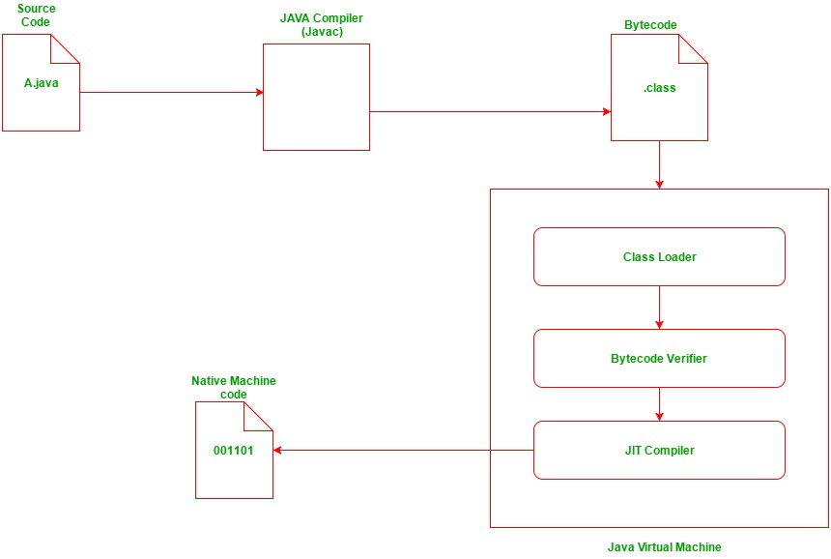
Compile and run in java

Slide 4
JDK,JRE and JVM
JDK - Compiles java to Byte Code. Consists of debuggers, Compilers etc.
JVM - Executes the byte code. JVM is the one which makes java platform independent. But JVM varies for platforms.
JRE - JVM along with java runtime libraries to execute java programs.

Slide 5
HOW TO CHECK JDK IS INSTALLED
Open your command prompt.
Type “java -version“ .
Download JDK
Goto Java SE download site @ http://www.oracle.com/technetwork/java/javase/downloads/index.html

Slide 6
WHAT IS ECLIPSE
Eclipse is an integrated development environment (IDE) used in computer programming, and is the most widely used Java IDE.^{[6]} It contains a base workspace and an extensible plug-in system for customizing the environment. Eclipse is written mostly in Java and its primary use is for developing Java app but it may also be used to develop applications in other programming languages via plug-ins, including Ada, ABAP, C, C++, C#, Clojure, COBOL, D, Erlang, Fortran, Groovy, Haskell, JavaScript, Julia,^{[7]} Lasso, Lua, NATURAL, Perl, PHP, Prolog, Python, R, Ruby (including Ruby on Rails framework), Rust, Scala, and Scheme.

Slide 7
HOW TO INSTALL ECLIPSE
Go to Software Center.
Go to Applications.
Find Eclipse Oxygen 4.7.
Click on install.

Slide 8
first PROJECT(“PRINT Hi”)
Open Eclipse
Create new project
Create new package
Create new class
public class PrintHi {
public static void main(String[] args) {
System.out.println("Hi");
}
}

Slide 9
Object and class
Object − Objects have states and behaviors. Example: A dog has states - color, name, breed as well as behaviors – wagging the tail, barking, eating. An object is an instance of a class.
Class − A class can be defined as a template/blueprint that describes the behavior/state that the object of its type support.

Slide 10
LOCAL , Instance and class variables
Local variables − Variables defined inside methods, constructors or blocks are called local variables. The variable will be declared and initialized within the method and the variable will be destroyed when the method has completed.
Instance variables − Instance variables are variables within a class but outside any method. These variables are initialized when the class is instantiated. Instance variables can be accessed from inside any method, constructor or blocks of that particular class.
public class Product {
public int barcode;
}

Slide 11
LOCAL , Instance and class variables
Class variables − Class variables are variables declared within a class, outside any method, with the static keyword.
public class Product {
public static int barcode;
}

Slide 12
Constructors
Constructors are used to initialize class and instance variables.
// A simple constructor.
class MyClass {
int x;
// Following is the constructor
MyClass(int i ) {
x = i;
}
}
public class ConsDemo {
public static void main(String args[]) {
MyClass t1 = new MyClass( 10 );
MyClass t2 = new MyClass( 20 );
System.out.println(t1.x + " " + t2.x);
}
}

Slide 13
Access Control Modifiers
Java provides a number of access modifiers to set access levels for classes, variables, methods and constructors. The four access levels are −
Visible to the package, the default. No modifiers are needed.
Visible to the class only (private).
Visible to the world (public).
Visible to the package and all subclasses (protected).
private boolean myFlag;
static final double weeks = 9.5;
protected static final int BOXWIDTH = 42;

Slide 14
Inheritance
Inheritance can be defined as the process where one class acquires the properties (methods and fields) of another. With the use of inheritance the information is made manageable in a hierarchical order.
The class which inherits the properties of other is known as subclass (derived class, child class) and the class whose properties are inherited is known as superclass (base class, parent class).
class Super {
}
class Sub extends Super {
}

Slide 15
Inheritance
class Calculation {
int z;
public void addition(int x, int y) {
z = x + y;
System.out.println("The sum of the given numbers:"+z);
}
public void Subtraction(int x, int y) {
z = x - y;
System.out.println("The difference between the given numbers:"+z);
}
}
public class My_Calculation extends Calculation {
public void multiplication(int x, int y) {
z = x * y;
System.out.println("The product of the given numbers:"+z);
}
public static void main(String args[]) {
int a = 20, b = 10;
My_Calculation demo = new My_Calculation();
demo.addition(a, b);
demo.Subtraction(a, b);
demo.multiplication(a, b);
}
}

Slide 16
Java - Overriding
If a class inherits a method from its superclass, then there is a chance to override the method provided that it is not marked final.
class Animal {
public void move() {
System.out.println("Animals can move");}}
class Dog extends Animal {
public void move() {
System.out.println("Dogs can walk and run"); }}
public class TestDog {
public static void main(String args[]) {
Animal a = new Animal(); // Animal reference and object
Animal b = new Dog(); // Animal reference but Dog object
a.move(); // runs the method in Animal class
b.move(); // runs the method in Dog class }}
Animals can move
Dogs can walk and run

Slide 17
overloading
Method Overloading is a feature that allows a class to have more than one method having the same name, if their argument lists are different. It is similar to constructor overloading in Java, that allows a class to have more than one constructor having different argument lists.
class DisplayOverloading
{
public void disp(char c)
{
System.out.println(c);
}
public void disp(char c, int num)
{
System.out.println(c + " "+num); }}
class Sample
{
public static void main(String args[])
{
DisplayOverloading obj = new DisplayOverloading();
obj.disp('a');
obj.disp('a',10); }}
OUTPUT
a
a 10

Slide 18
SUPER KEYWORD
The super keyword refers to the objects of immediate parent class.
class Superclass
{
int num = 100;
}
class Subclass extends Superclass
{
int num = 110;
void printNumber(){
/* Note that instead of writing num we are
* writing super.num in the print statement
* this refers to the num variable of Superclass
*/
System.out.println(super.num);
}
public static void main(String args[]){
Subclass obj= new Subclass();
obj.printNumber();
}
}
Output:
100

Slide 19
Abstract Class
A class that is declared using “abstract” keyword is known as abstract class. It can have abstract methods(methods without body) as well as concrete methods (regular methods with body).
For using the abstract class , a class has extend the abstract class and implement the methods.
//abstract parent class
abstract class Animal{
//abstract method
public abstract void sound();}
//Dog class extends Animal class
public class Dog extends Animal{
public void sound(){
System.out.println("Woof");}
public static void main(String args[]){
Animal obj = new Dog();
obj.sound(); }}
Output:
Woof

Slide 20
INTERFACE
Interface looks like a class but it is not a class. An interface can have methods and variables just like the class but the methods declared in interface are by default abstract.
Since methods in interfaces do not have body, they have to be implemented by the class before you can access them. The class that implements interface must implement all the methods of that interface.

Slide 21
INTERFACE
interface MyInterface
{
public void method1();
public void method2();
}
class Demo implements MyInterface
{
public void method1()
{
System.out.println("implementation of method1");
}
public void method2()
{
System.out.println("implementation of method2");
}
public static void main(String arg[])
{
Demo obj = new Demo();
obj.method1();
}}
Output:
implementation of method1

Slide 22
Array
An array is a collection of similar type of elements that have a contiguous memory location.
class Testarray{
public static void main(String args[]){
int a[]=new int[5];//declaration and instantiation
a[0]=10;//initialization
a[1]=20;
a[2]=70;
a[3]=40;
a[4]=50;
//traversing array
for(int i=0;i<a.length;i++)//length is the property of array
System.out.println(a[i]);
}}

Slide 23
ARRAY(Multidimensional )
class Testarray3{
public static void main(String args[]){
//declaring and initializing 2D array
int arr[][]={{1,2,3},{2,4,5},{4,4,5}};
//printing 2D array
for(int i=0;i<3;i++){
for(int j=0;j<3;j++){
System.out.print(arr[i][j]+" ");
}
System.out.println();
}
}}

